Slide 1







sport team management system
Group Members:
Puteri Nurin I’rdina
Seri Nur Ayuni
Farah Hazirah Nisha
Sarah Sofea

Slide 2

Project description
The Sports Team Manager allows users to store data about sports management including the athletes, coach, manager, training session, sports, and events in a more organized way. For instance, we can view, add and remove the athlete’s details, teams, team’s member and the events of the sport and also their training. First of all, the system will prompt the user to insert the number that is provided in the system (1-3) which will manage the athlete, manage the team, and exit the system. The system will prompt the user to either want to use the existing athlete/team data or want to add a new athlete/team. Next the user will be given 8 options to manage the athlete and team which are to recruit an athlete into the team, remove an athlete from the team, add a training session, remove a training session, add a sports event, cancel a sports event, display team details and exit the athlete/team management menu. All of the options have two options inside them which are either want to use the existing data or add new data except for canceling a sports event, remove an athlete from the team, remove a training session and exit option.

Slide 3
CLASS DESIGNS
FLOWCHART
2. CLASS DIAGRAM

Slide 4
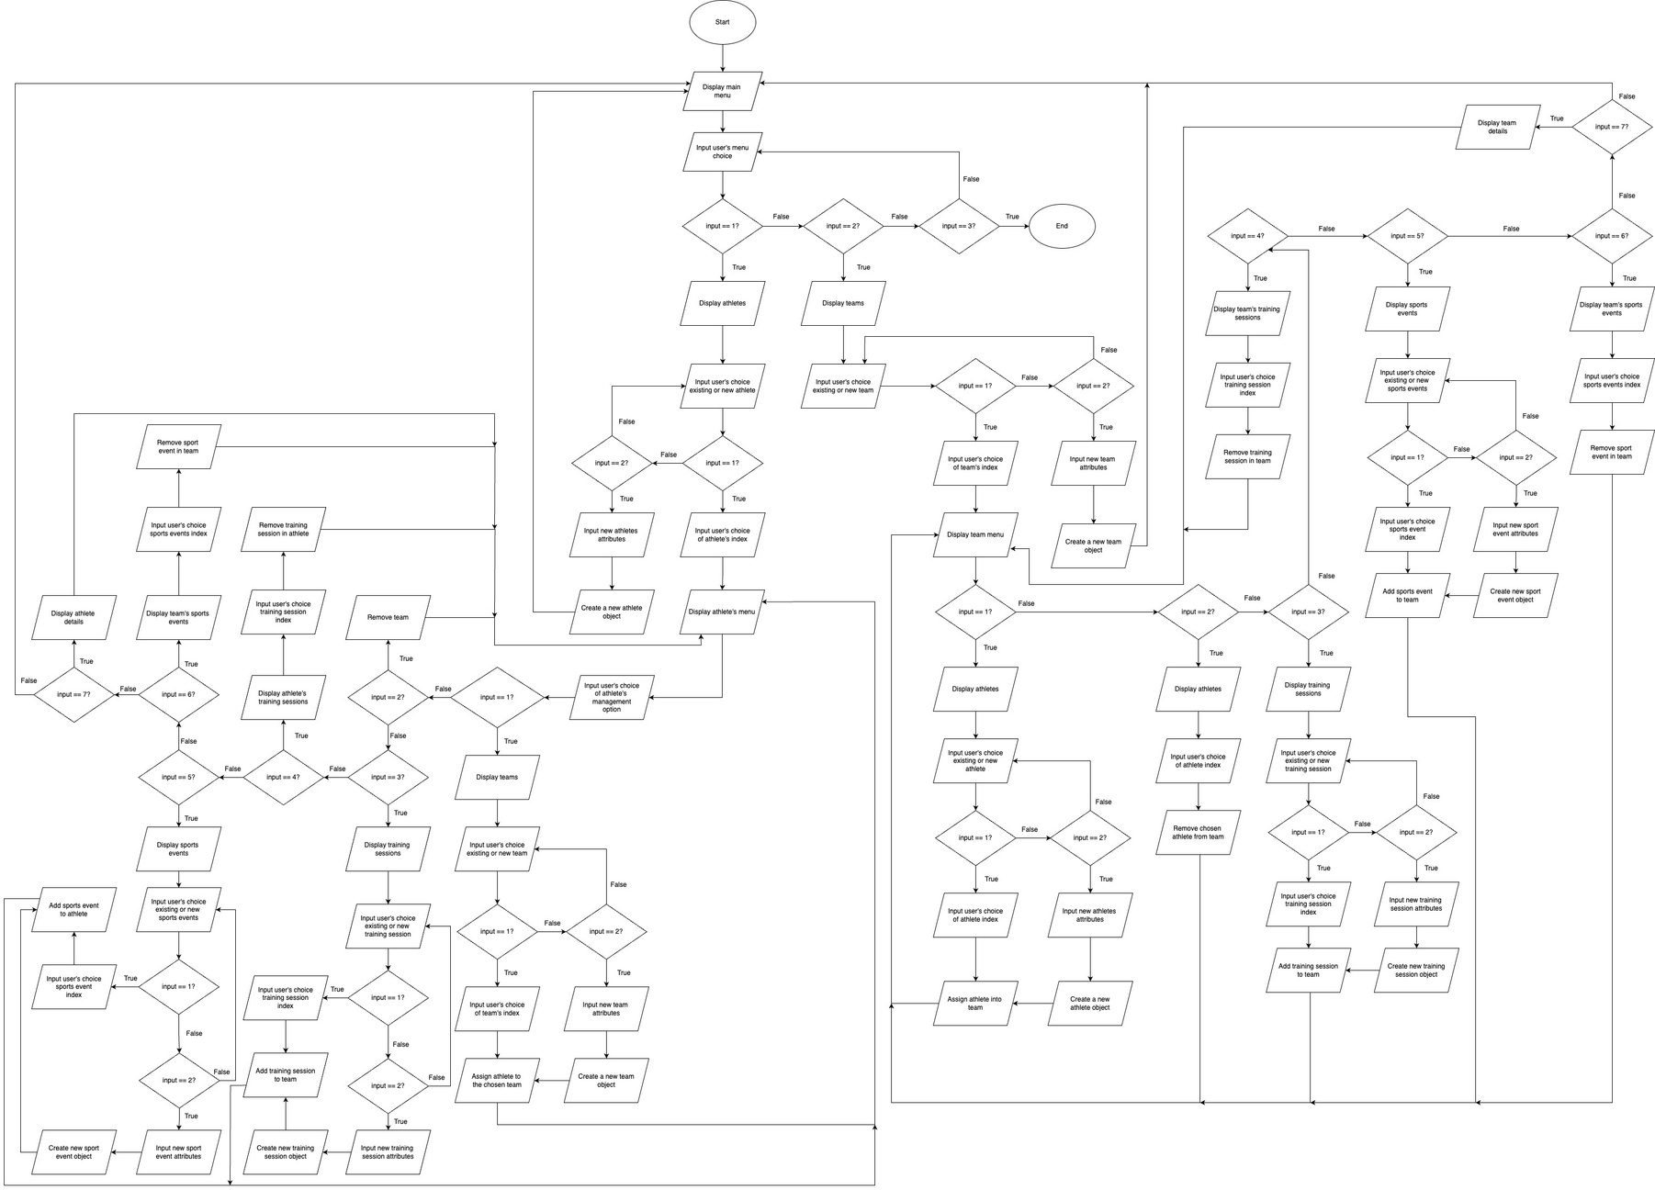
OVERALL FLOWCHART OF THE SYSTEM

Slide 5
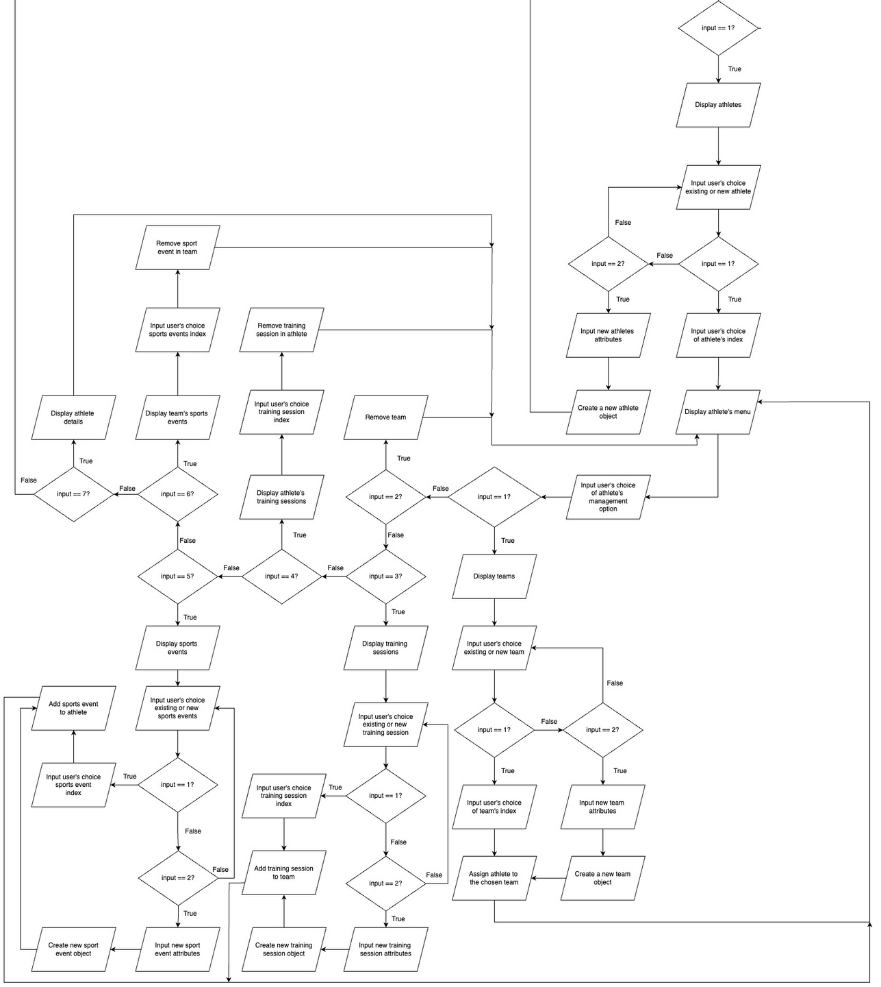
ATHLETE
MANAGE-MENT FLOW

Slide 6
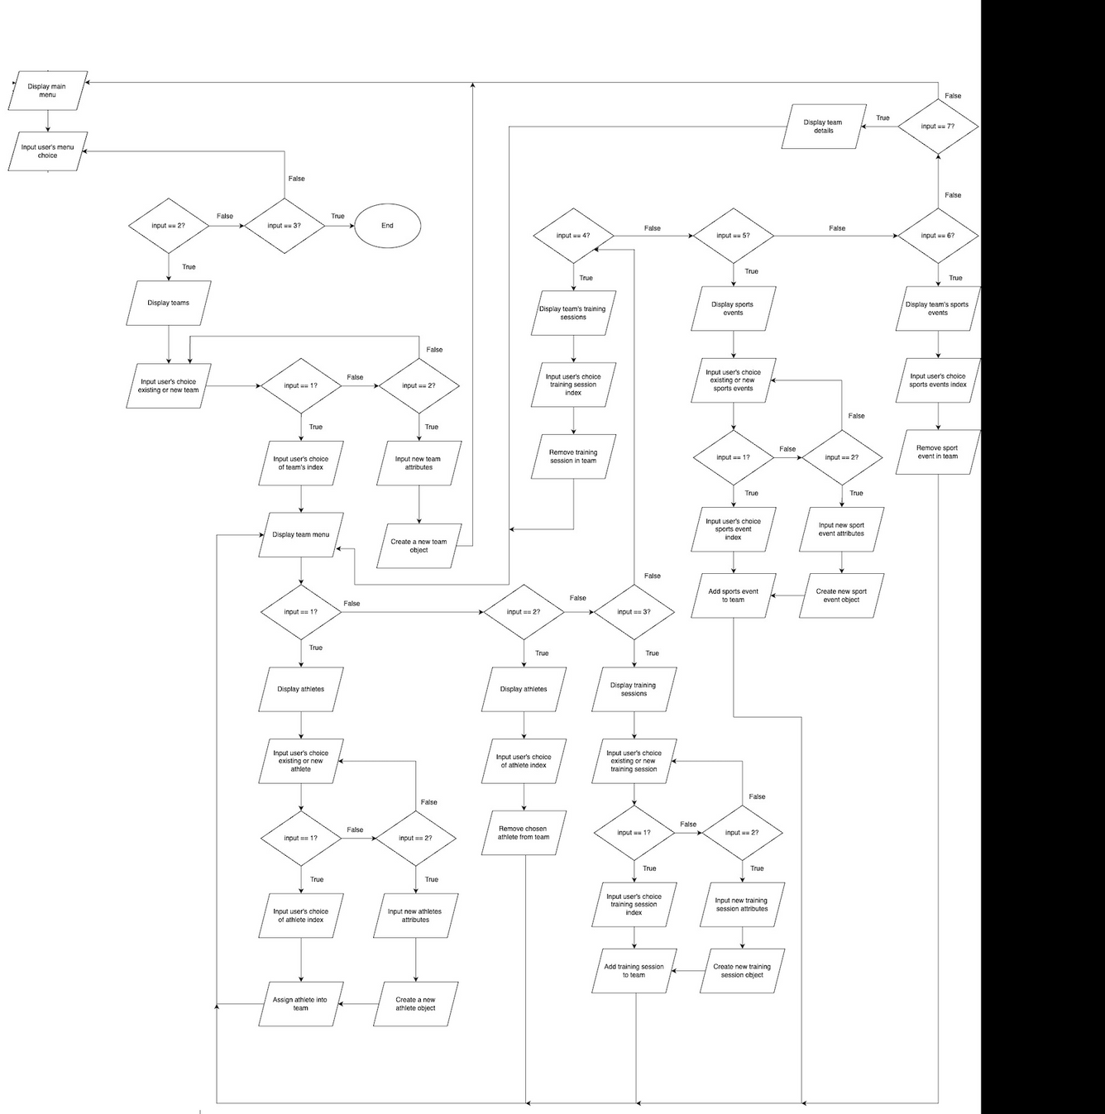
TEAM
MANAGE-MENT AND EXIT FLOW

Slide 7
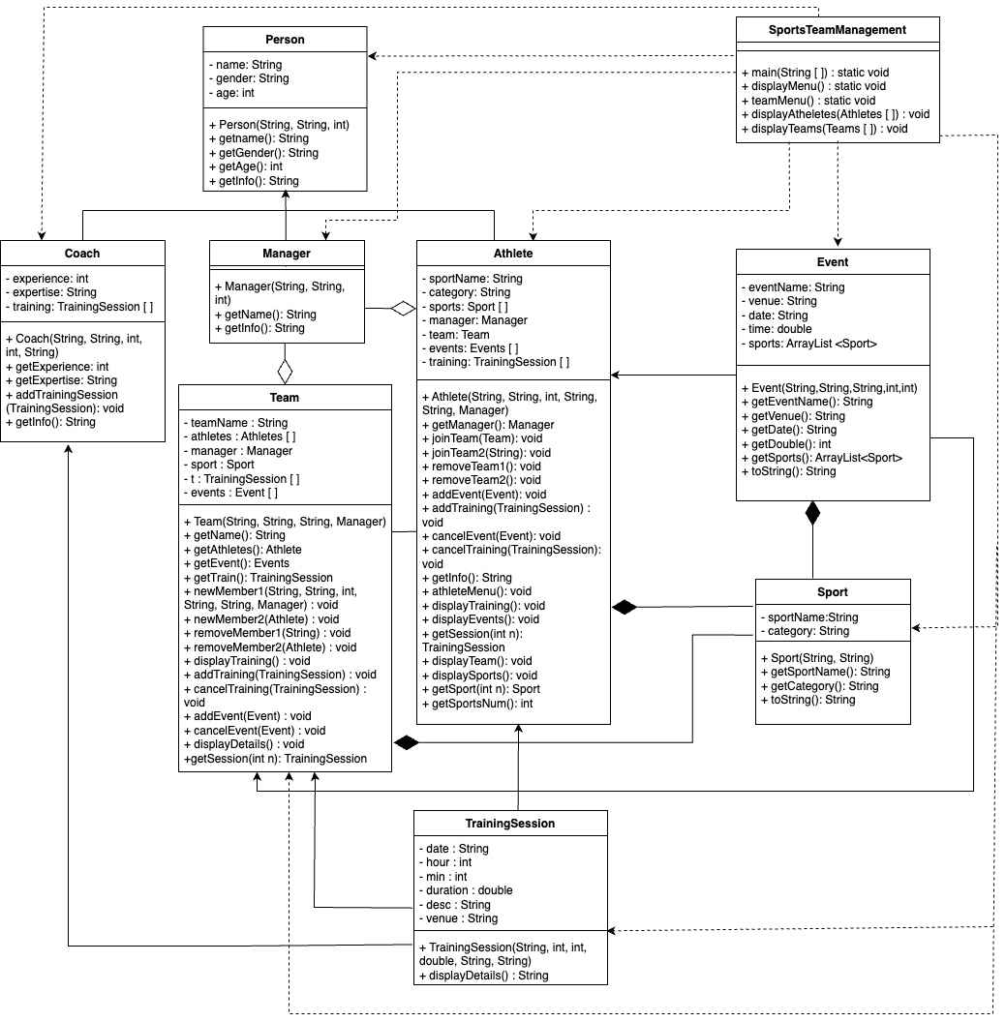
class diagram

Slide 8

OO CONCEPT
Classes and Object
Constructor
Encapsulation and Data Hiding
Association
Composition
Aggregation
Inheritance
Polymorphism
Exception Handling

Slide 9

classes and object
Class
Blueprint that describes the structure and behavior shared by all objects of a specific kind.
For this management system, we already decided to use 9 classes which consist of class Person,Coach,Manager,Athletes,Team,TrainingSession,Event,Sport and also SportsTeamManagement (main method).
Each class consists of their own attribute and method.
Object
Instances of classes created during runtime.
Each object has its own attributes and can perform methods defined in its class.

Slide 10
ENCAPSULATION
constructor
AND DATA HIDING
For data hiding using encapsulation, we declared each attribute in each class as private.
This will prevent direct access to the attribute hence ensuring the data integrity.
To access this attribute we need to use an accessor or also known as getter (ex: getName() in ‘Person’ class).
Special kind of methods for creating instance of the class
Each class that we created have one constructor
Constructors are called when the keyword ‘new’ is used to create an object.

Slide 11
ASSOCIATION
Represent general binary relationships that describe an activity between two classes.
We implement both unidirectional(one-way) and bidirectional navigability.
By using association, it allows objects to call methods in other objects. As an example, addTrainingSession(TrainingSession) method can be called in ‘Coach’.
It enables one class to gain information about another and interact with its objects.

Slide 12

COMPOSITION
Composition is a strong form of aggregation.
The parts (object of another class) belong to one whole class and does not change during the execution. [Strong Ownership].
As an example, ‘Athlete’ class needs at least one ‘Sport’ object. An ‘Athlete’ cannot exist without being associated with a ‘Sport’.

Slide 13

AGGREGATION
Aggregation is a special form of association, “has-a” relationship.
Relationship where one whole class contains parts (objects of another class). [Weak Ownership]
As an example, ‘Athlete’ class does not necessarily need to have a ‘Manager’ object. It still can execute even if the ‘Athlete’ does not have a ‘Manager’.
Allows part objects to exist independently of the whole object.

Slide 14

INHERITANCE
Inheritance implements the “is-a” relationship that consists of superclass(general class) and subclass(specialized class).
Process which a new class is created from anothe class.
Allow subclass to inherits the attributes and methods of the superclass.
As an example, ‘Person’ is a superclass that allow other classes such as ‘Coach’, ‘Manager’ and ‘Athlete’ to inherit all the attributes and methods.

Slide 15
POLYMORPHISM
Polymorphism is when the same method call can lead to different behaviors.
Allows methods to be overridden.
Polymorphism also uses dynamic binding that determines the method to be invoked during runtime based on the object type not the reference type.
‘getInfo()’ method can lead to different behaviors depending on which it is invoked. As an example, if it is called by object ‘Coach’, it will return name, gender, age, experience and expertise. Meanwhile, if it is called by object ‘Manager’, it will return name, gender, age and office.

Slide 16

EXCEPTION
HANDLING
For exception handling, we decided to use a do…while loop.
The user will be ask to enter choice 1-3 (Manage Athlete(s), Manage Team(s) and Exit) only, if the user enter any other number, the system will keep looping until the correct input is entered.

